Slide 1
Lower back injury

Slide 2
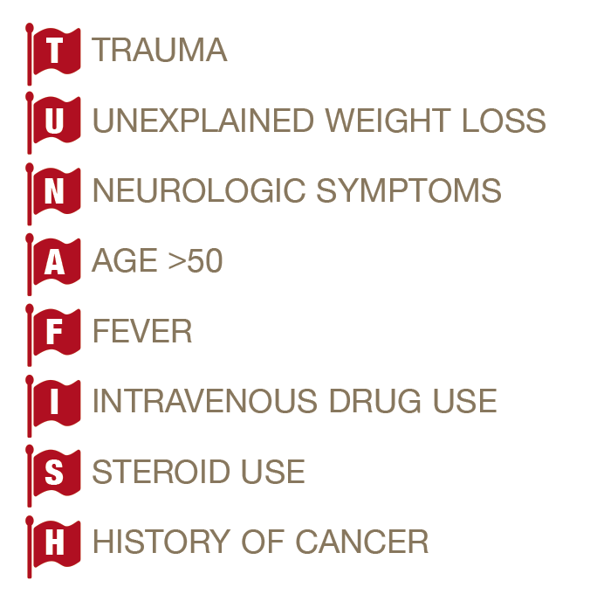

Slide 3
Examination
LOOK
FEEL
MOVE

Slide 4
Neurological examination legs
Tone
Power
MRC 0-5
Reflexes
Knee L4
Ankle S1
Sensation, dermatomes

Slide 5
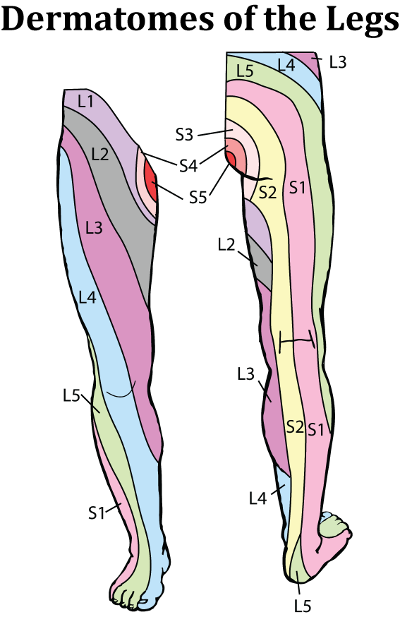

Slide 6
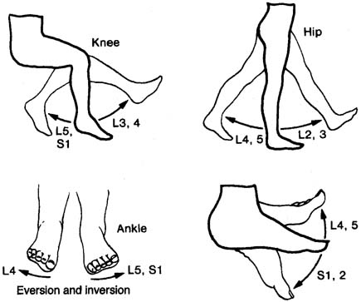

Slide 7
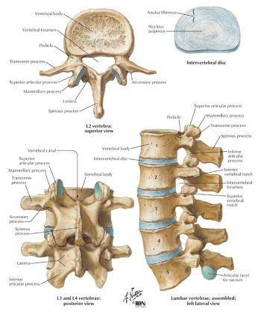

Slide 8
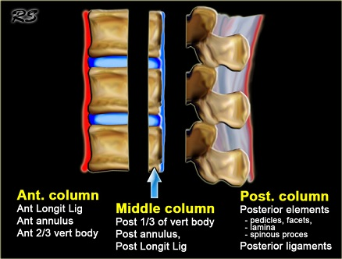

Slide 9
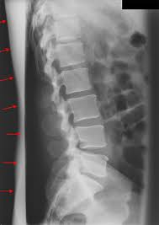

Slide 10
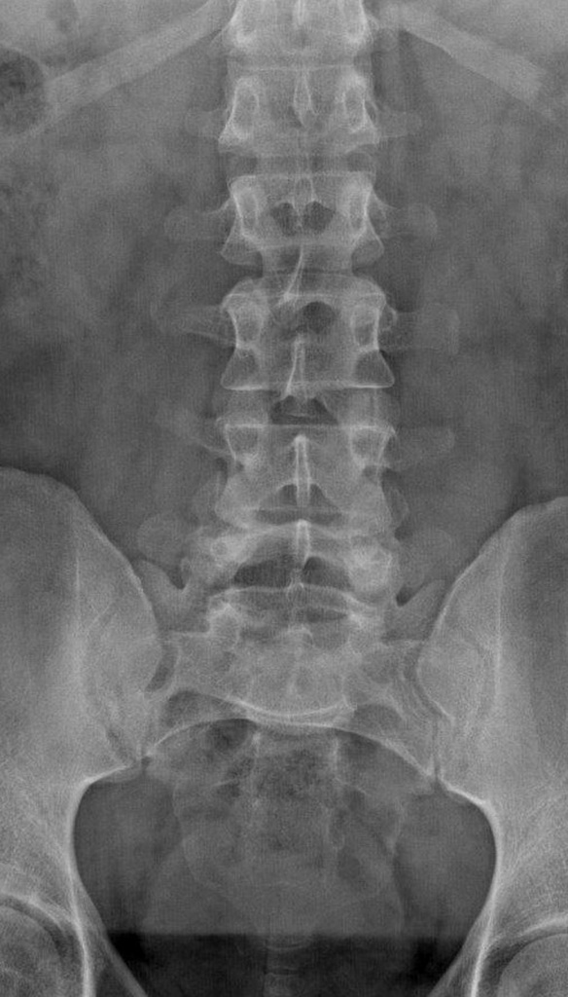

Slide 11
Vertebral fractures
Wedge
Crush
burst

Slide 12
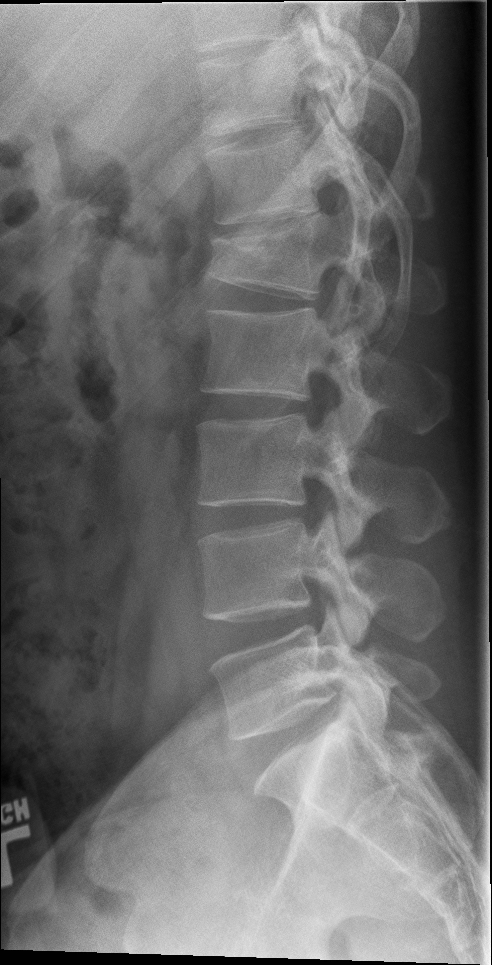

Slide 13
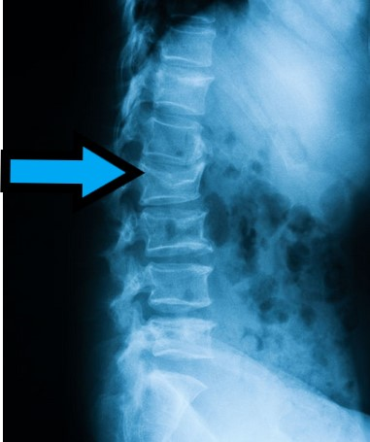

Slide 14
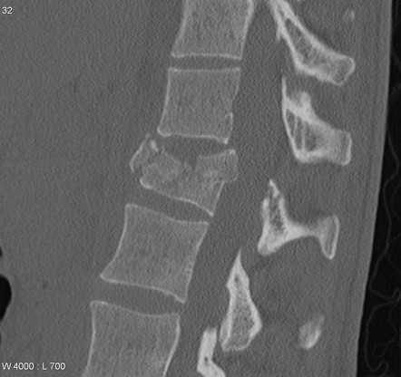

Slide 15
Back injury and Haematuria
Frank v microscopic
Obs
mechanism

Slide 16
Cauda Equina:

Slide 17
