Slide 1
Paediatric elbow INJURIES
Enp teaching
22/12/21
Zoe smeed

Slide 2
Aims/objectives
EXAMINATION TIPS
Critol
Xr interpretation
Common presentations - #, DISLOCATIONS, PULLED ELBOW
PAEDS TIPS

Slide 3
EXAMINATION
Look – feel - move
BSUH Paediatric Guidelines

Slide 4
EXAMINATION
Look – feel - move
BSUH Paediatric Guidelines

Slide 5
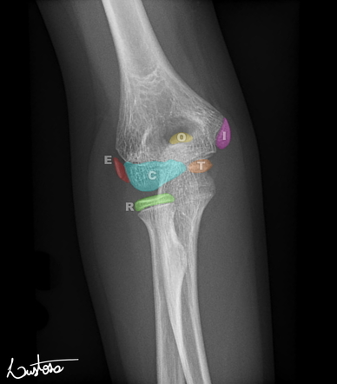
critol
= OSSIFICATION CENTRES WITH AGE:
Capitellum
Radial head
Internal epicondyle
Trochlea
Olecranon
Lateral epicondyle
6m
12 yrs
*** I BEFORE T***

Slide 6
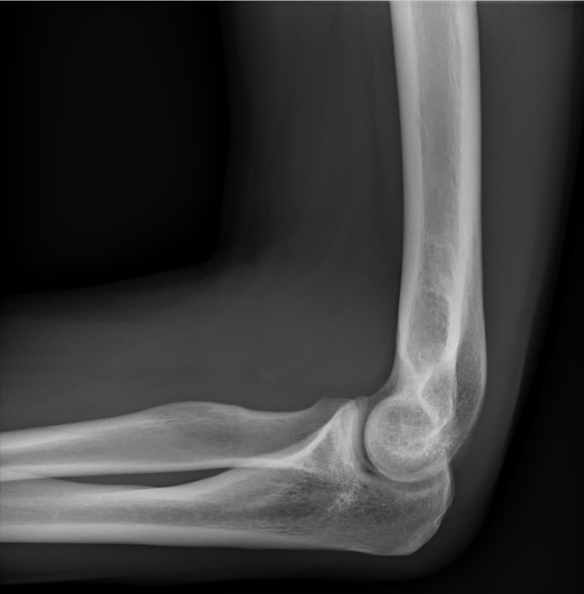
XR INTERPRETATION

Slide 7
XR INTERPRETATION
Are the fat pads normal?
Anterior – may be normal
Posterior – underlying pathology

Slide 8
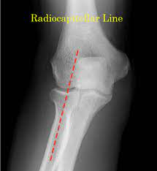
XR INTERPRETATION
Are there fat pads?
Radiocapitellar line:
Line should pass through centre of capitellum and longitudinal axis radial head and neck
If not:
? Is this a true lateral
? Dislocation of radial head

Slide 9
XR INTERPRETATION
Are there fat pads?
Radiocapitellar line:
Anterior humeral line:
>1/3 capitellum anterior to AHL
If not ?supracondylar #

Slide 10
XR INTERPRETATION
Are there fat pads?
Radiocapitellar line:
Anterior humeral line:
4. Are ossification centres in correct order?
BSUH Paediatric Guidelines

Slide 11
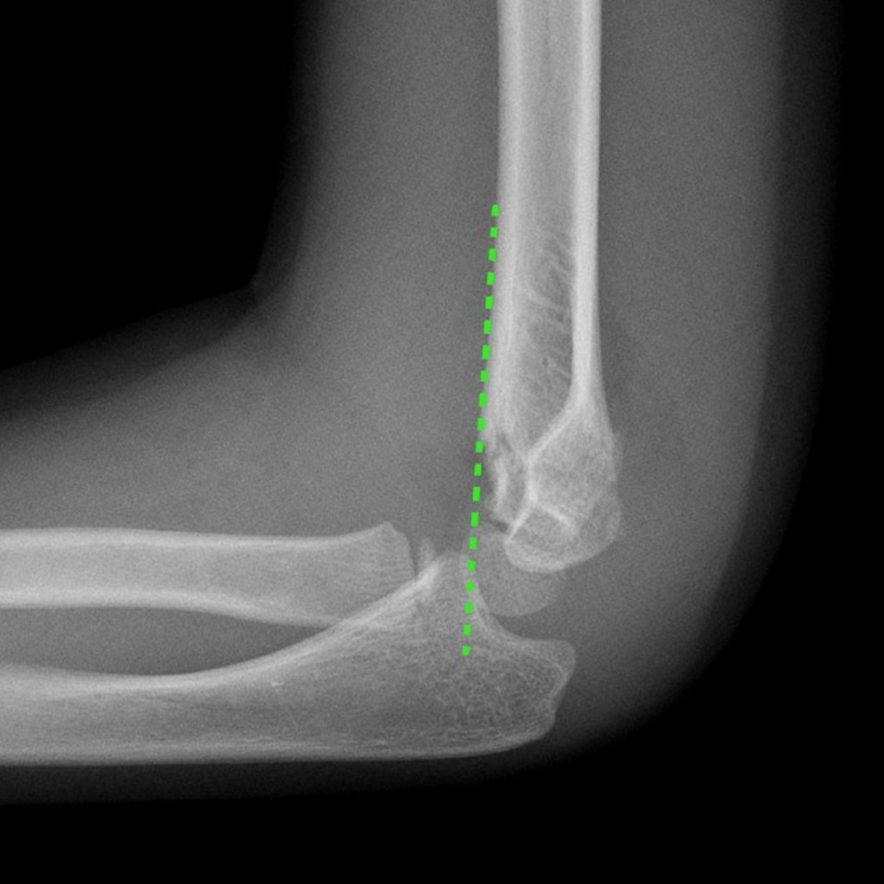
COMMON INJURIES – SUPRACONDYLAR #
Commonest # 4-8yo
FOOSH (5% direct fall)
Beware – significant risk neurovasc injury
Undisplaced: high above elbow cast, VFC
Displaced: Ortho on call

Slide 12
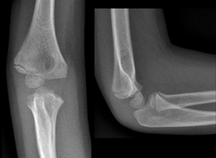
LAT CONDYLE
6-10 YRS
Often displaced - ortho

Slide 13
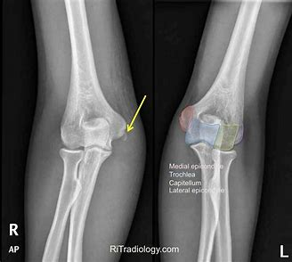
medial EPICONDYLE
7-15YRS
50% associated with dislocation

Slide 14
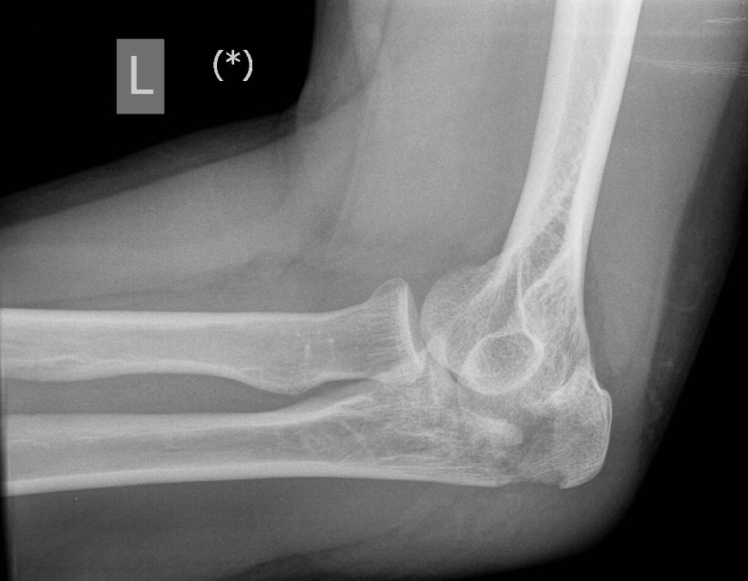
Olecranon fracture
Often associated med/lat condyle /radial head #
Risk neurovasc injury.
Above elbow BS - ortho
Undisplaced VFC

Slide 15
Radial head/neck
Typically FOOSH
Pain & reduced flex/ext & pronation/supination
Comminuted/angulated: above elbow BS
Others: BAS
VFC/PIL

Slide 16
Elbow DISLOCATION
Posterior & lateral displacement during forced movement
Swollen, deformed, slight flexion
Often associated med/lat condyle /radial head #
Neurovasc status
Longitudinal traction, slight flexion under safe sedation.
Above elbow BS & Ortho
** 5% associated with distal radius injury***
BSUH Paediatric Guidelines

Slide 17
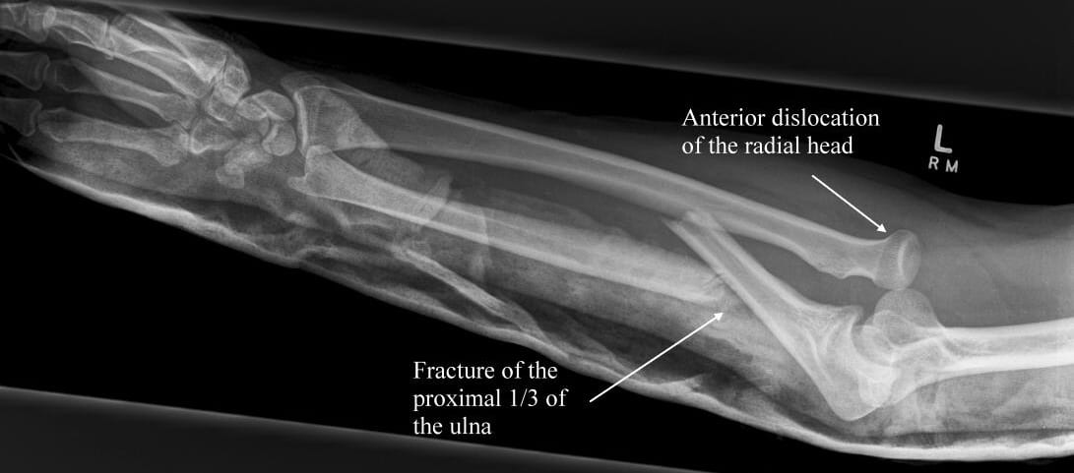
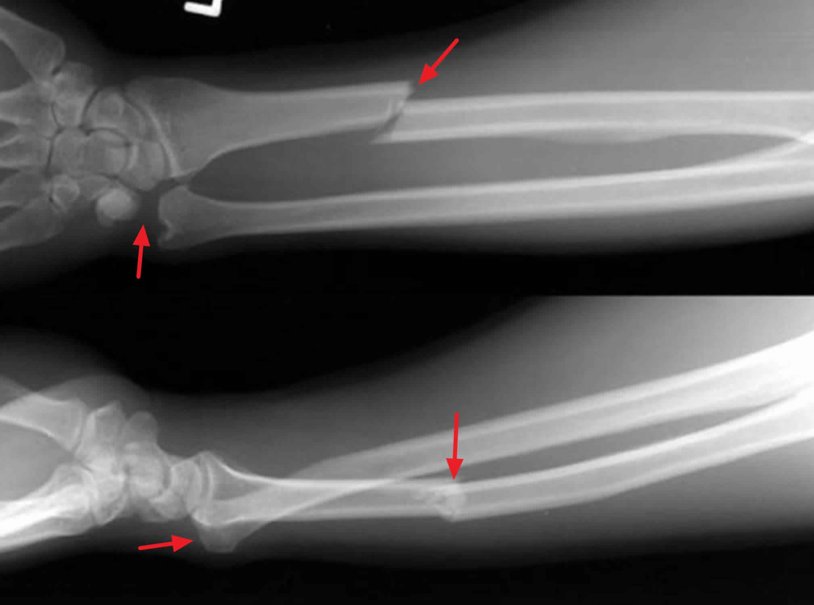
Monteggia vs galleazzi
# ulna shaft, dislocation radioulna joint
# radius, dislocation radioulnar joint
Above elbow backslab & ortho

Slide 18
PULLED ELBOW

Slide 19
PULLED ELBOW
BSUH Paediatric Guidelines

Slide 20
PAEDS TIPS
LOOK-FEEL-MOVE
NEUROVASC STATUS
PAEDS PROFORMAS/ NAI
IMAGING RULES
MOI AND COMMON PRESENTATIONS
CEM/CLINICIAN ADVICE

