Slide 1
ENP Teaching Paediatric Facial Wound Closure
Doug Maxwell

Slide 2
Aims
Local anaesthetic options
Closure options
Cases

Slide 3
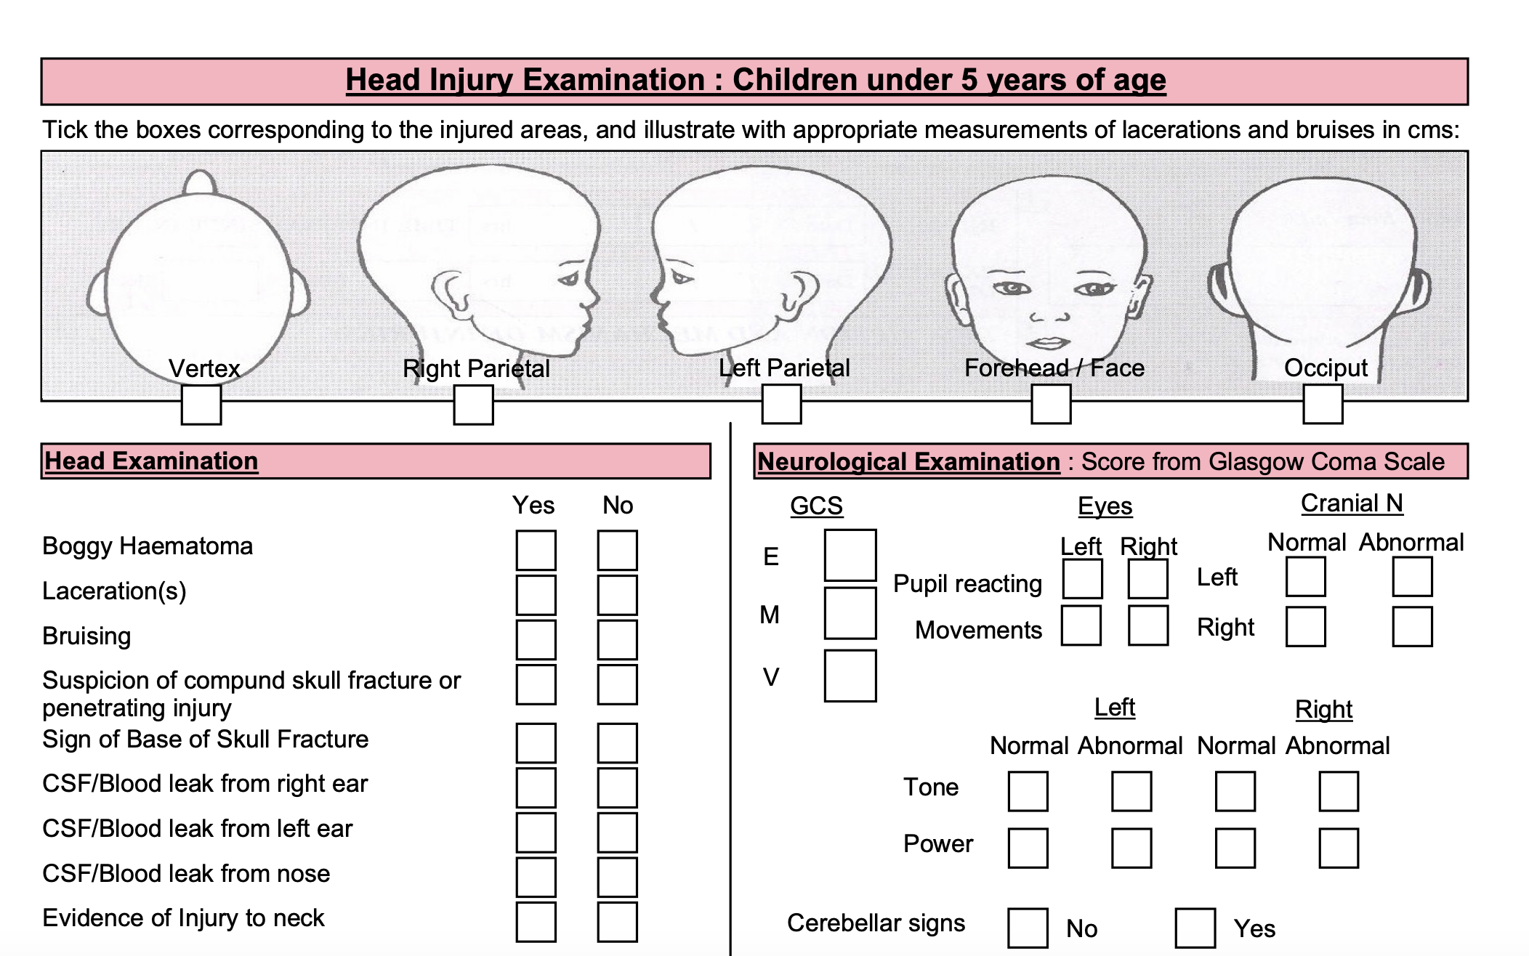

Slide 4
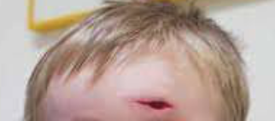
Initial Management?
ABCDE
Obs
Analgesia
Local Anaesthetic
Wound Management
Closure

Slide 6
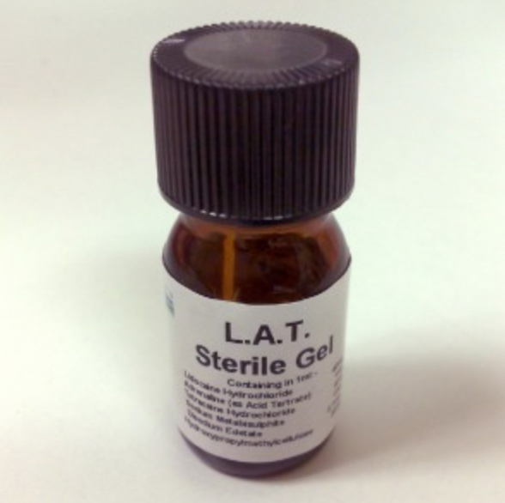
LAT Gel
Lignocaine, Adrenaline & Tetracaine

Slide 7
LAT Gel
EMLA / Amitop unsuitable alternatives = systemic absorption & toxicity
Children >1 year old with simple laceration to head / torso / limb
Wound less than 5cm
Dose:
0.5 – 1ml per cm of wound length up to Max:
2 ml aged 1-3
3ml >3
Max wound length = 5cm
Do not use in:
Allergy to amide anaesthetics (LA)
Gross contamination
Involving mucous mambranes / genitalia / nose / digits / ear
Bite, crush or flap wound
Unable to determine depth / beyond subcut layer

Slide 8
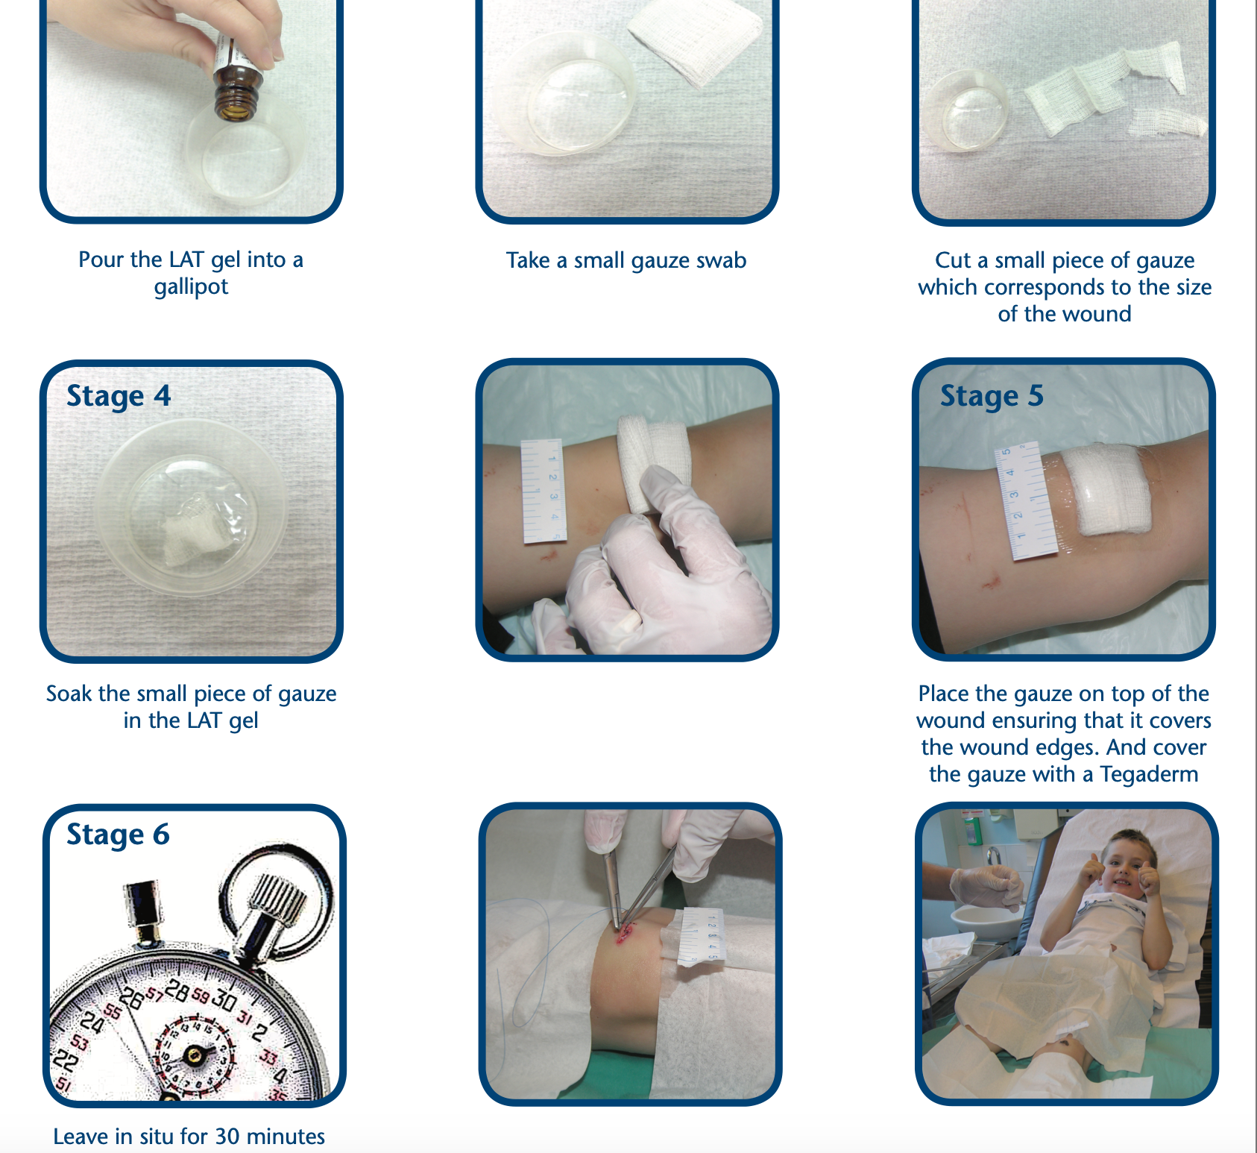

Slide 9
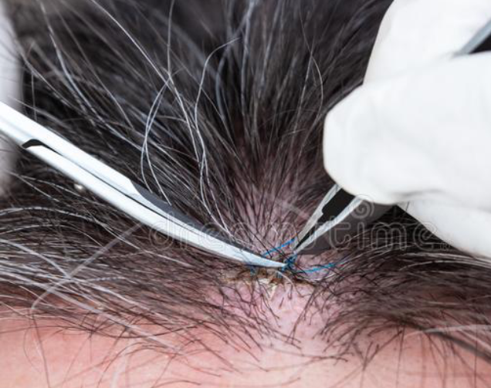
Closure

Slide 10
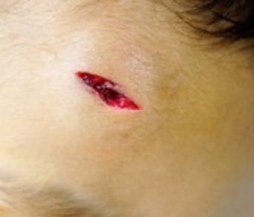

Slide 12
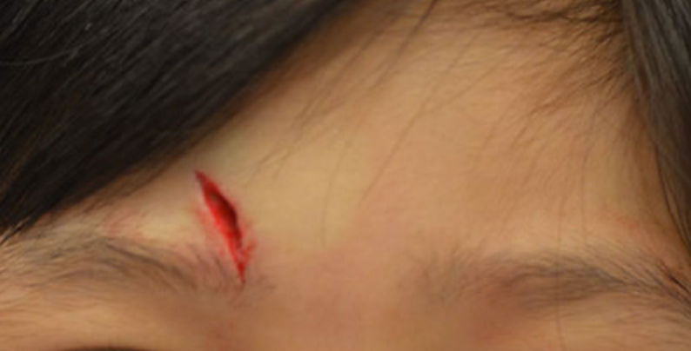

Slide 13
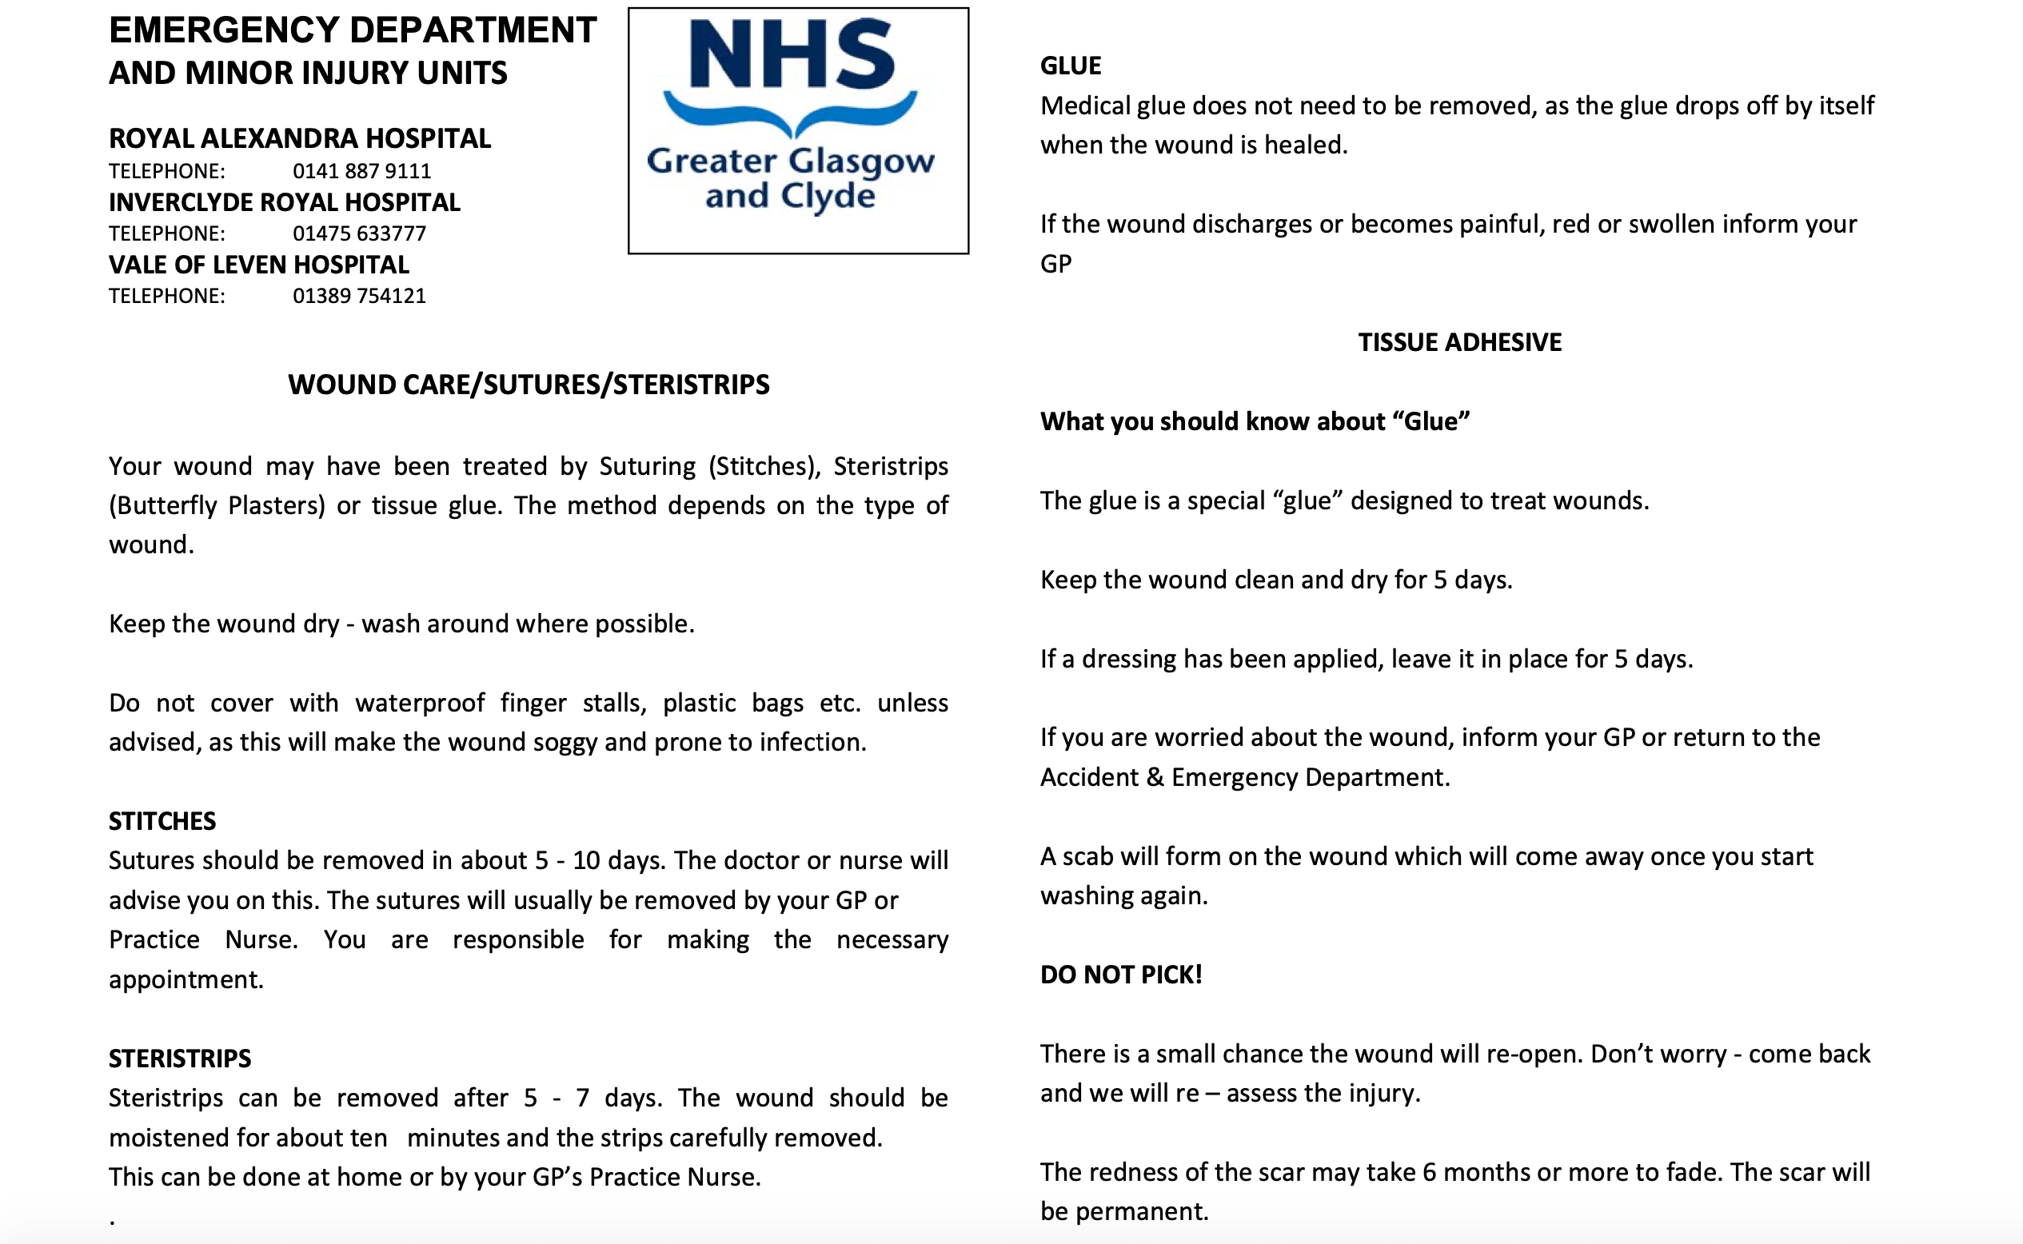

Slide 14
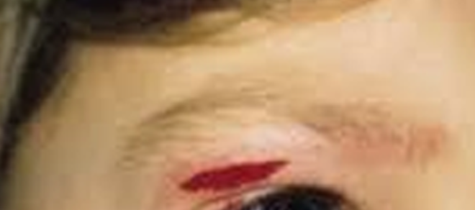

Slide 15
Careful with Glue!

Slide 16
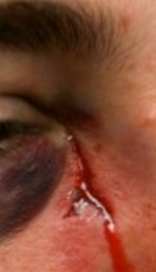
Further caution

Slide 17
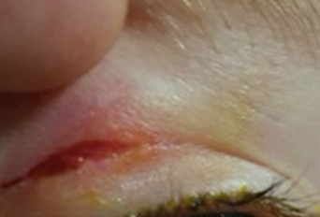
? Suitable to close

Slide 18
Always consider NAI…

Slide 19
Questions?

