Slide 1
Wound Management Quick Quiz
Teaching 30/5/18
Doug Maxwell

Slide 3
Case 1

Slide 4
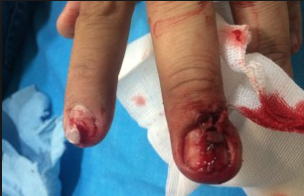
Fingertip

Slide 5
Fingertip
Any injury to finger distal to DIPJ = Fingertip
Early primary closure with nailbed repair has best outcome
Most nail avulsions have associated nailbed (sterile matrix) laceration
Key areas to document / repair are germinal and sterile matrix
If unable to close primarily then refer

Slide 8
Case 2

Slide 9
Dog Bite
Pasteurella sp esp P.canis
Mostly sensitive to Co-Amoxiclav
Always consider Tetanus
Generally avoid primary closure if simple puncture wound (unless facial)
Refer if:
Asociated cellulitis / systemic upset
Crush injury underlying bite
Extensive / deep wound – requiring surgical debridement
Complex facial wound
Anything other than simple puncture wound to hand

Slide 10
Case 3

Slide 11
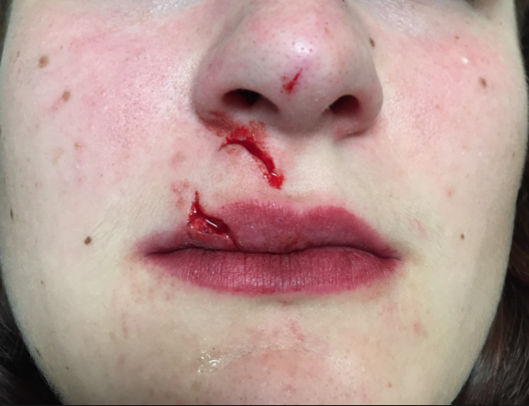
Lip Lac

Slide 12
Lip Lac
Low threshold for referral esp Paediatric
Must oppose vermillion border
Mucosal only wounds best left to heal by secondary intention (esp if bitten through)
‘Through and through’ wound – irrigate ++ and close externally
Chlorhexidine oral rinse useful on discharge

Slide 14
Case 4

Slide 15
High Pressure Injection Injury

Slide 17
High Pressure Injection Injury
Often non-dominant hand from paint gun etc
Often trivial external wound with catastrophic deep tissue devitalisation
Must also consider toxicological impact
All require surgical exploration

Slide 18
Case 5

Slide 19
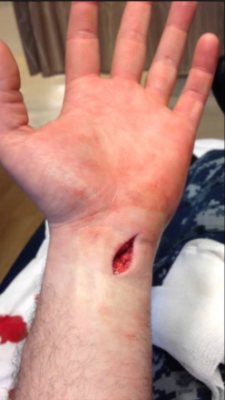
Wrist Wound

Slide 23
Case 6

Slide 25
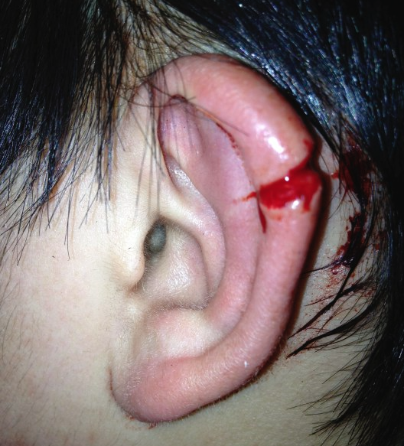
Pinna Laceration
Aim is to completely cover the cartilage with skin to avoid necrosis
Can use absorbable sutures to approximate wound initially or simply interrupted 5/0 or 6/0 to oppose
Do posterior first prior to closing anterior
Refer any ragged / complex pinna wound

Slide 26
Pinna Laceration

Slide 27
Pinna Laceration

Slide 28
Case 7

Slide 29
Tetanus
Clostridium tetani
Environmental spores (highly resistant) form gram positive bacillus
1 million deaths worldwide per year
Suitable environment > spore germination > bacteria multiply > toxin release
Tetanospasmin / Tetanolysin
Triad of rigidity, muscle spasm and autonomic instability
Incubation 3-14d
Onset 1-7d
UK Vaccine introduced 1961

Slide 30
Vaccine Schedule

